Slide 1
Hierarchical Clustering Starbucks Coffee Data
By: Kerrie Mars
Kent State University
Fall 2022 Fundamentals of Machine Learning
12/10/2022

Slide 2

Business Problem
GOAL: Provide offerings of Starbucks coffees to encourage employees to return to office while also being health conscious.
Analyze nutritional data provided by Starbucks for various coffee drinks and determine what type of coffees and drinks will be offered in the office space and paid for by the company.
Note: Expenses associated with project analysis and execution are fully covered by the CEO as a personal donation with the hopes of eliminating WFH at our company.

Slide 3
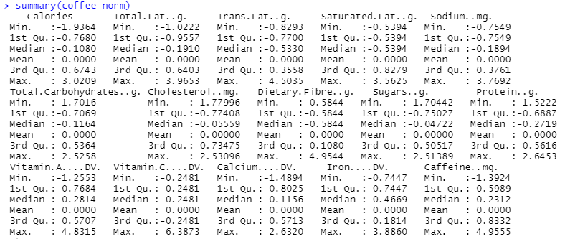
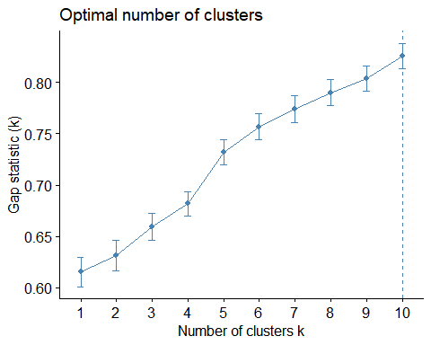
Approach – Utilized Hierarchical Clustering
Data was tested with normalizing, and not normalizing to determine the best outcome.
Normalizing the data in this situation skews the values of the nutritional content.
10 clusters and 2 various clusters were tested. Due to the variations in the data, 10 clusters were ultimately used.
Nutritional Summary of Starbucks Coffee Drinks

Slide 4
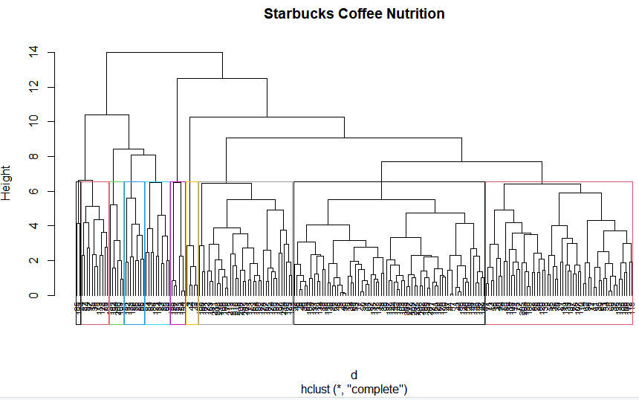
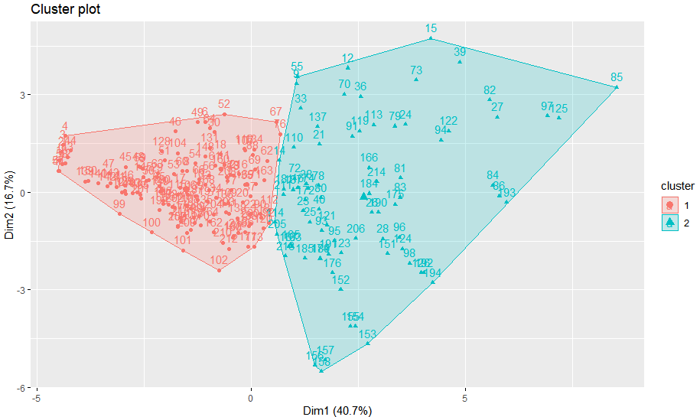
Conclusion
In summary, coffee drinks included in Cluster 6 have the healthiest nutritional value while also providing the highest caffeine content which is important to our employees.

